Slide 1
Faith In Action
Featured Programs
Derek J. Finley
State Program Director
Knights of Columbus Mississippi State Council
(734) 355-0903
Dfinley2021@yahoo.com
Notes:
Mark.McMullen@Kofc.Org

Slide 2
WHY PROGRAMS??
Our Goal as Knights of Columbus is to lead our families and communities in faith and service through our local councils’ programs.
FAITH IN ACTION
Faith Programs: To strengthen men and their families in the Catholic faith.
Family Programs: Enhance the bonds of families in our parishes by providing programs for families by families.
Community Programs: Serving others in our communities exemplifies our Charity principle.
Life Programs: Defending the dignity of each human being at every stage of life.
Notes:
Mark.McMullen@Kofc.Org

Slide 3
Programs (P)=
Member Engagement (ME) + Member Retention (MR)
Programs (P)=
Council Exposure (CE) + Member Recruitment (MRe)
Notes:
Mark.McMullen@Kofc.Org

Slide 4
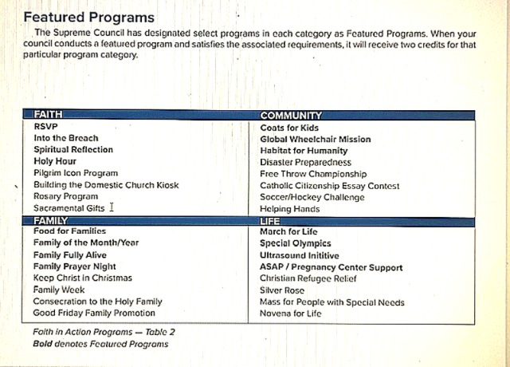

Slide 5
RSVP-REFUND SUPPORT VOCATIONS PROGRAM
Councils are required to donate at least $500 to an individual seminarian or religious aspirant.
For every $500 given to an individual, the Supreme Council will refund the council or assembly $100. The maximum refund a council or assembly can receive is $400 per individual supported. Report Activity via RSVP Refund Application (#2863).
Faith Programs - Faith in Action | Knights of Columbus
Notes:
Mark.McMullen@Kofc.Org

Slide 6
HOLY HOUR
Councils are required to hold at least four Holy Hours (quarterly) or organize and support two Holy Hours and at least one Eucharistic Procession.
Report Activity via Program Report Form (#10784).
Faith Programs - Faith in Action | Knights of Columbus
Notes:
Mark.McMullen@Kofc.Org

Slide 7
INTO THE BREACH
Councils are required to hold eight sessions to discuss the content of the original Into the Breach video series or apostolic exhortation (#340) or five sessions of Into the Breach: The Mission of the Family video series.
Report Activity via Program Report Form (#10784).
Faith Programs - Faith in Action | Knights of Columbus
Notes:
Mark.McMullen@Kofc.Org

Slide 8
SPIRITUAL REFLECTION
Councils are required to host or attend a Spritual Reflection for the men of the council and the parish that is at least a day long and is attended by 10 men or 10% of your council, whichever is fewer.
Report Activity via Program Report Form (#10784).
Faith Programs - Faith in Action | Knights of Columbus
Notes:
Mark.McMullen@Kofc.Org

Slide 9
FAITH PROGRAMS
-RSVP-Refund Support Vocations Program
-Holy Hour
-Into The Breach
-Spritual Reflection
-Pilgram Icon
-Rosary Program
Faith Programs - Faith in Action | Knights of Columbus
Notes:
Mark.McMullen@Kofc.Org

Slide 10
FOOD FOR FAMILIES
Councils are required to collect a minimum of $500 or 1,000 pounds of food for a parish or community food pantry. In addition, councils must contribute a minimum of 100 total man-hours in preparation/distribution /service of meals.
Report Activity via Food for Families Refund and Plaque Application (#10057).
Family Programs - Faith in Action | Knights of Columbus
Notes:
Mark.McMullen@Kofc.Org

Slide 11
FAMILY OF THE MONTH/YEAR
Councils are required to recognize twelve families throughout the fraternal year: one for each month. In addition, each council should submit a Family of the Year to their jurisdiction’s competition.
Report activity using the Program Report Form (#10784) and the Family of the Year Entry Form (#10680).
Family Programs - Faith in Action | Knights of Columbus
Notes:
Mark.McMullen@Kofc.Org

Slide 12
FAMILY FULLY ALIVE
Councils are required to distribute and actively promote the use of the Family Fully Alive Booklets.
Report activity using the Program Report Form (#10784).
Family Programs - Faith in Action | Knights of Columbus
Notes:
Mark.McMullen@Kofc.Org

Slide 13
FAMILY PRAYER NIGHT
Councils are required to organize at least four Family Prayer Nights, one for each quarter of the year.
Report activity using the Program Report Form (#10784).
Family Programs - Faith in Action | Knights of Columbus
Notes:
Mark.McMullen@Kofc.Org

Slide 14
FAMILY PROGRAMS
-Food For Families
-Family of the Month/Year
-Family Fully Alive-Distribute booklets
-Family Prayer Night
-Keep Christ In Christmas
-Good Friday Family Promotion
Family Programs - Faith in Action | Knights of Columbus
Notes:
Mark.McMullen@Kofc.Org

Slide 15
COATS FOR KIDS
Councils are required to purchase a minimum of 6 cases of Supreme offered coast and host a distribution event.
Report activity using the Programs Report Form (#10784).
Community Programs - Faith in Action | Knights of Columbus
Notes:
Mark.McMullen@Kofc.Org

Slide 16
GLOBAL WHEELCHAIR MISSION
Councils are required to donate the equivalent of 10 wheelchairs at $150 per chair to the American Wheelchair Mission or the Canadian Wheelchair Foundation, by raising funds through council, parish or community activities.
Report activity using the Programs Report Form (#10784).
Community Programs - Faith in Action | Knights of Columbus
Notes:
Mark.McMullen@Kofc.Org

Slide 17
HABITAT FOR HUMANITY
Councils are required to donate a minimum of $1,000 or 200 service hours to a Habitat for Humanity project in their community.
Report activity using the Programs Report Form (#10784).
Community Programs - Faith in Action | Knights of Columbus
Notes:
Mark.McMullen@Kofc.Org

Slide 18
COMMUNITY PROGRAMS
-Coats for Kids
-Global Wheelchair Mission
-Habitat For Humanity
-Disaster Preparedness
-Soccer/Hockey Challenge
Community Programs - Faith in Action | Knights of Columbus
Notes:
Mark.McMullen@Kofc.Org

Slide 19
MARCH FOR LIFE
Councils are required to organize a minimum of 25 marchers to participate in a national, state or local March for Life or councils must themselves organize a March for Life.
Report activity using the Programs Report Form (#10784).
Life Programs - Faith in Action | Knights of Columbus
Notes:
Mark.McMullen@Kofc.Org

Slide 20
SPECIAL OLYMPICS
Councils are required to contribute a minimum of 200 man-hours in support of state/local Special Olympics activities, or must raise a minimum of $2,000 for Special Olympics.
Report activity using the Programs Report Form (#10784).
Life Programs - Faith in Action | Knights of Columbus
Notes:
Mark.McMullen@Kofc.Org

Slide 21
PREGNANCY CENTER SUPPORT/ASAP (Aid and Support After Pregnancy)
Councils are required to contact a local Pregnancy Center to assess its needs and support the center through fundraising, volunteering, or prayer. Also, through ASAP, for every $500 a council donates to a qualifying pregnancy resource center or maternity home (up to $2,000), the Supreme Council will donate $100 more.
Life Programs - Faith in Action | Knights of Columbus
Notes:
Mark.McMullen@Kofc.Org

Slide 22
ULTRASOUND
Councils are required to identify a Pregnancy Center that meets the requirements listed on the Diocesan Evaluation (#10715). Upon approval from the Supreme Council, a council raises 50% of the cost of the ultrasound machine. The council must then obtain the remaining 50% from the Supreme Council. Qualification will also be determined from the information provided the Ultrasound Application (#10716).
Life Programs - Faith in Action | Knights of Columbus
Notes:
Mark.McMullen@Kofc.Org

Slide 23
LIFE PROGRAMS
-March for Life
-Special Olympics
-Pregnancy Center Support/ASAP
-Ultrasound Program
-Silver Rose
-Novena For Life
Life Programs - Faith in Action | Knights of Columbus
Notes:
Mark.McMullen@Kofc.Org

Slide 24
How Can We Improve Program Reporting?
-Delegate one member of each council to work on council activity report and other program reporting
-During council officer meetings, fill out program reports while the accomplishments are fresh on their mind
-Councils should discuss program reporting with District Deputy. Having another editor and advisor can be helpful.
Notes:
Mark.McMullen@Kofc.Org

Slide 25
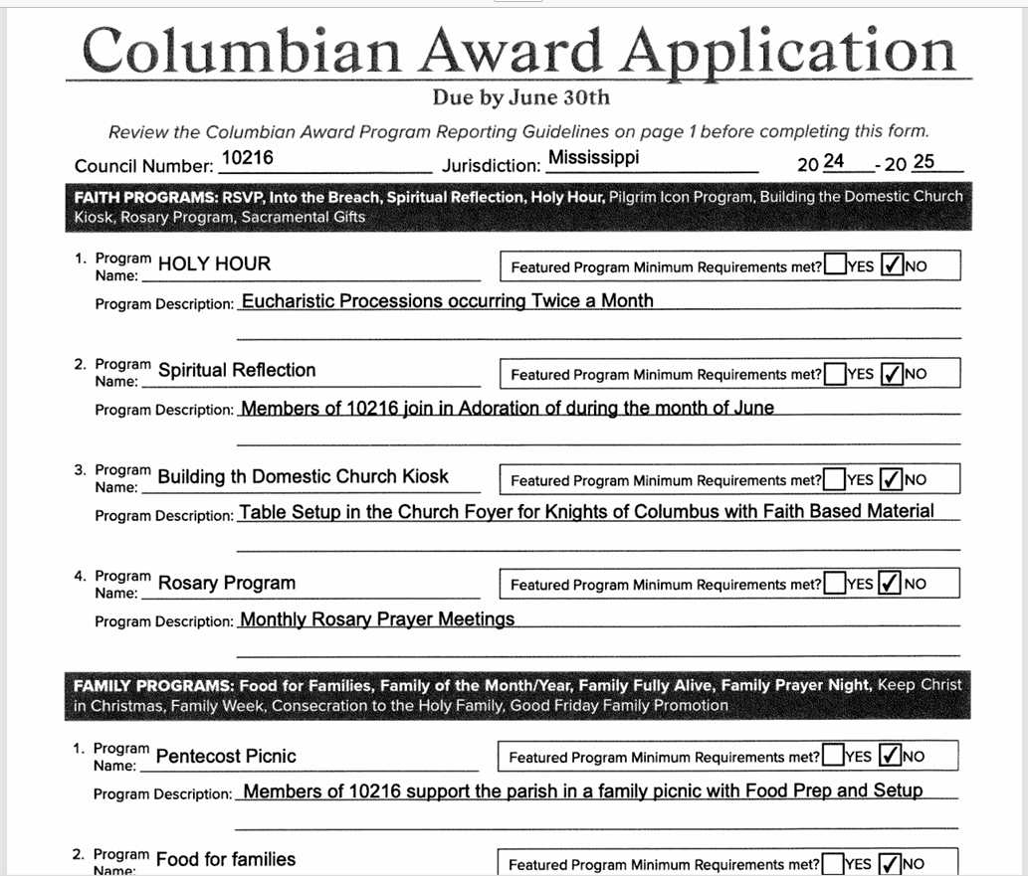
SUPREME PROGRAM REPORTING
Notes:
Mark.McMullen@Kofc.Org

Slide 26
STATE AWARDS-COUNCIL ACTIVITY REPORT
- 5 programs in each area for HONOR COUNCIL
- 6 programs in each area and achieve membership goal for COUNCIL OF EXCELLENCE
- 6 programs in each area and achieve both membership and FBE goals for DISTINGUISHED COUNCIL
- 8 activities in each area and achieve both membership and FBE goals for STELLAR COUNCIL
* Found on state directory at https://kofc-ms.org
Notes:
Mark.McMullen@Kofc.Org

Slide 27
COUNCIL ACTIVITY REPORT (Review & Access)

Slide 28
Program Directors:
Faith Director: Michael "Mak" Kersanac-(228) 216-2442- mak@emac-llc.com
Family Director: Michael "Doug" Leo-(601) 529-4978-DLeo@kllm.com
Community Director: John Barnes-(662) 801-9981-ujohnmbarnes68@gmail.com
Life Director: Basil Demarest-(478) 714-7618- basil.demarest@att.net
State Program Director:
Derek Finley-(734) 355-0903-dfinley2021@yahoo.com
STATE PROGRAM CONTACTS
Notes:
Mark.McMullen@Kofc.Org

